Slide 1
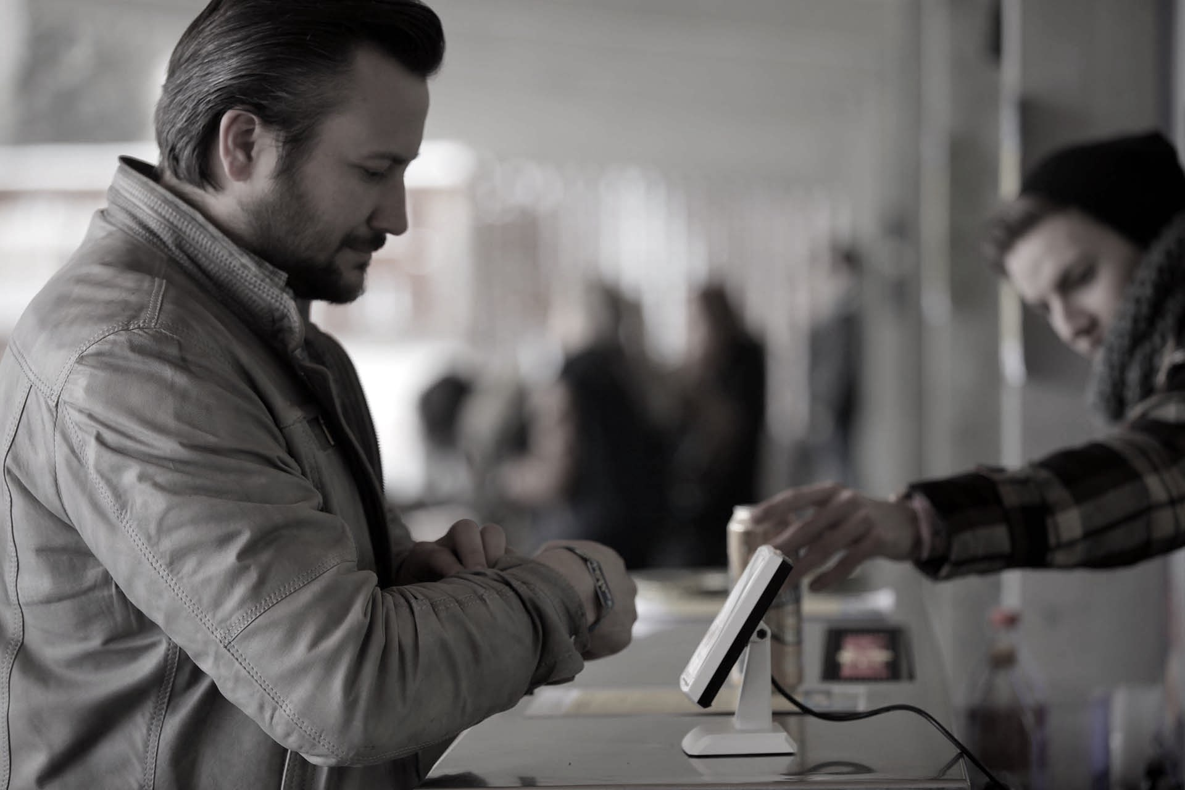

THE FUTURE
OF CASHLESS
PAYMENT
KONRAD HEFELLE
APRIL 20, 2016
Notes:
Hello everyone, thanks for joining me, my name is Konrad Hefelle, I’m a lead UX developer at EPAM systems and today I’m going to talk about the future of cashless payment and how I envisioned EPAM in 2018 dealing with financial challenges.

Slide 2
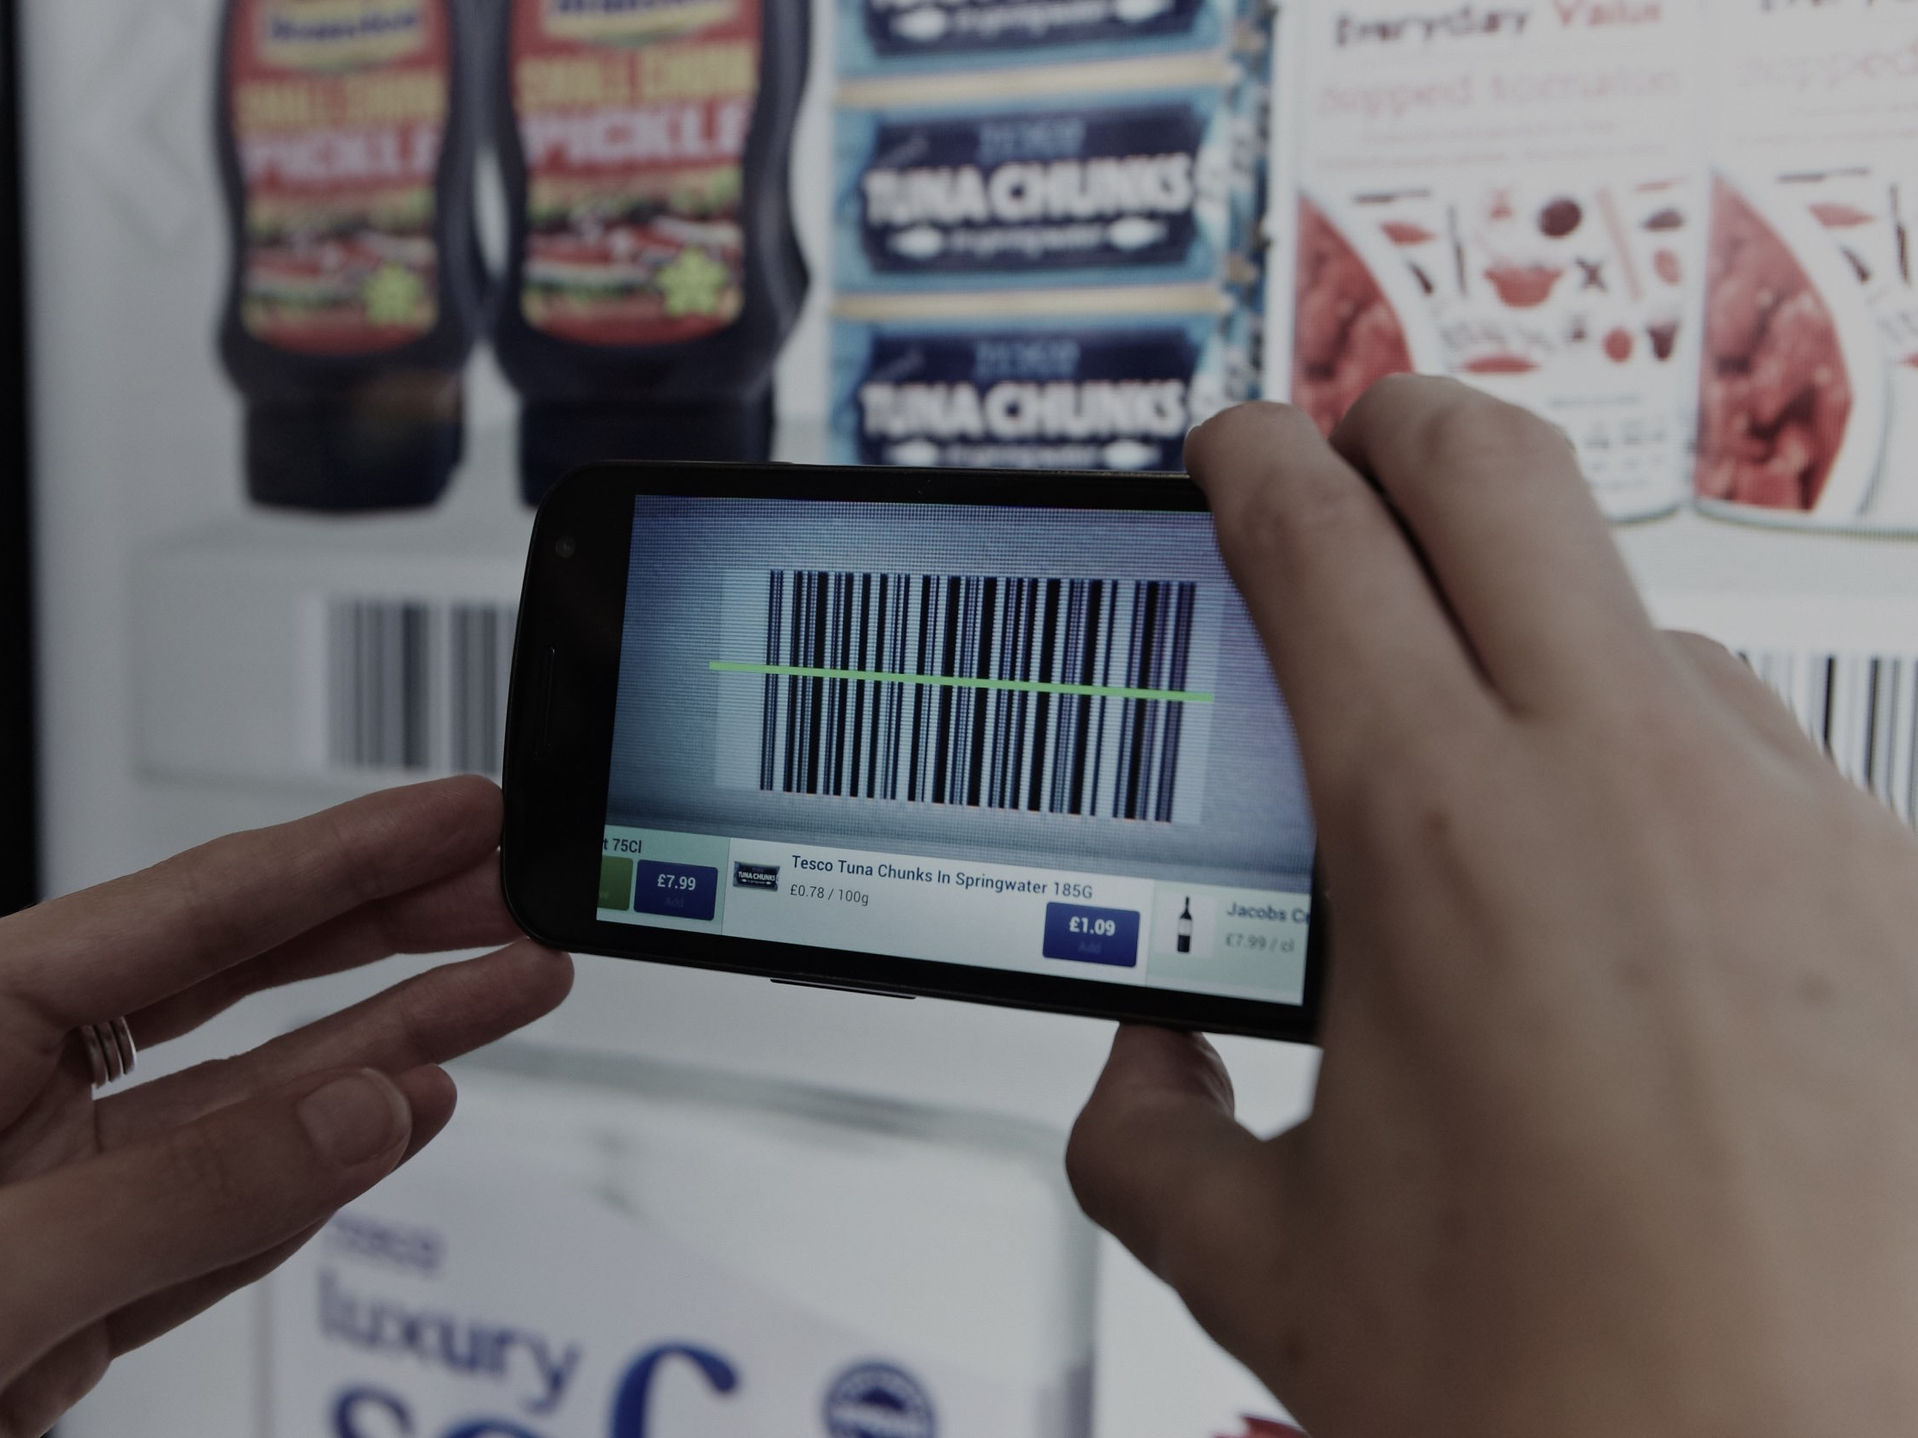
HOW WE SHOP AND HOW WE PAY IS GOING THROUGH A SIGNIFICANT CHANGE
Notes:
If you’re interested in finance, almost everyday you can read something new about a new online solution, or a special shopping possibility, new customer habits, heavy competition in the financial market, regulations, security breaches etc.
How we shop and how we pay is going through a significant change
Why? In the first part of my presentation I try to answer this question, I try to give you a picture about the present of payments.
As an example Tesco in South Korea, have a service called Home Plus.
They created images of items and show them across the walls of train platforms -- the same way as they would be in the shop. Every item has a QR code, and people waiting on the platform can scan the QR code of the chosen item using their mobile. This immediately adds it to their Home Plus shopping basket.
The idea was to make online shopping more visually appealing at a time when people are captive and bored: when they're waiting for a train.
what are the key factors of the current environment?

Slide 3
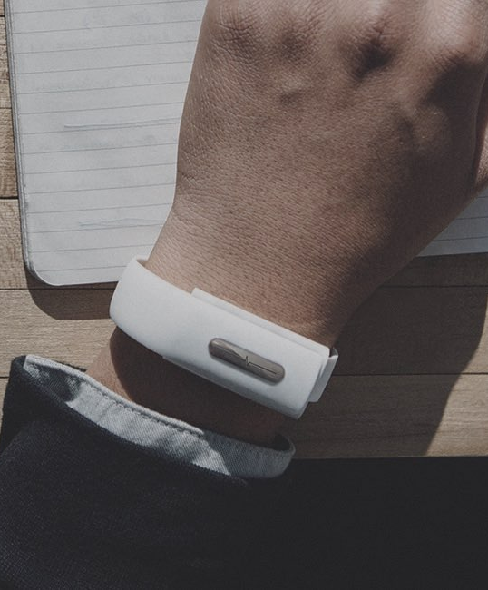
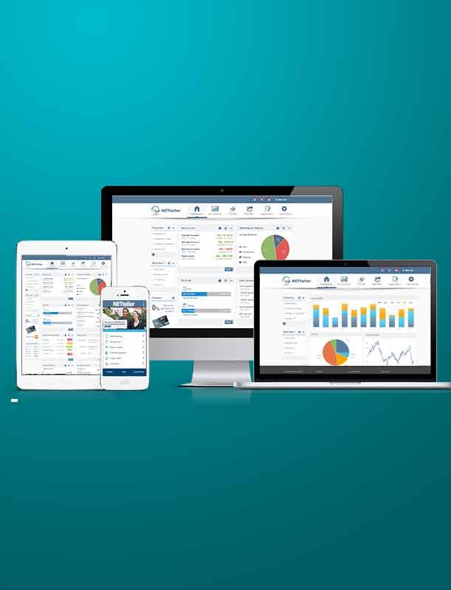
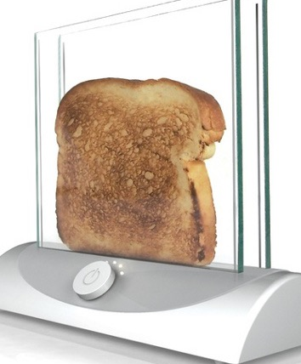
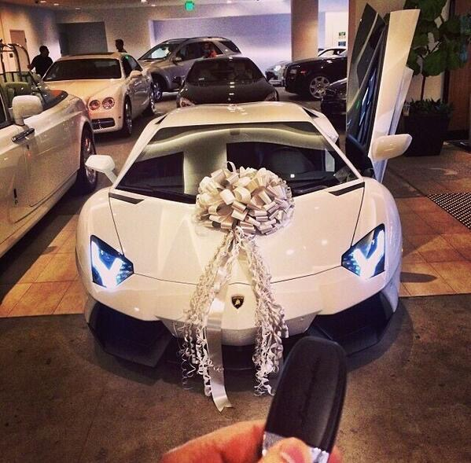
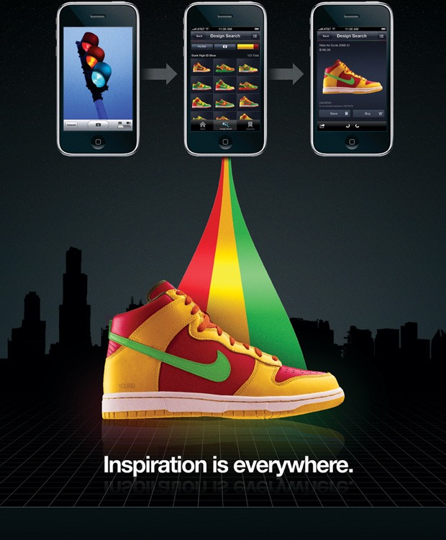

THE EMPOWERED CONSUMER
Seemingly unlimited knowledge
Borderless reach
They choose what, when and how they buy
They expect….
Engaging experiences
Personalised service
Instant gratification
Seamless transition between channels
Innovative relevant and secure solutions
Notes:
One key factor is the consumers.
The todays consumers are empowered with seemingly unlimited knowledge, because of their smartphones and mobile internet, and they can shop anywhere, so they can choose what, when and how they buy.
And what do they expect?
They’re expecting engaging experiences, they wan to be part of the process, e.g. they want to see how the bread became brown in a transparent toaster. They expect fully personalised services, and instant reward for their actions.
They expect to start a process on a smartphone, continue it on an iPad and finish it on a desktop, without any problem, and of course they want it in a secure way.

Slide 4
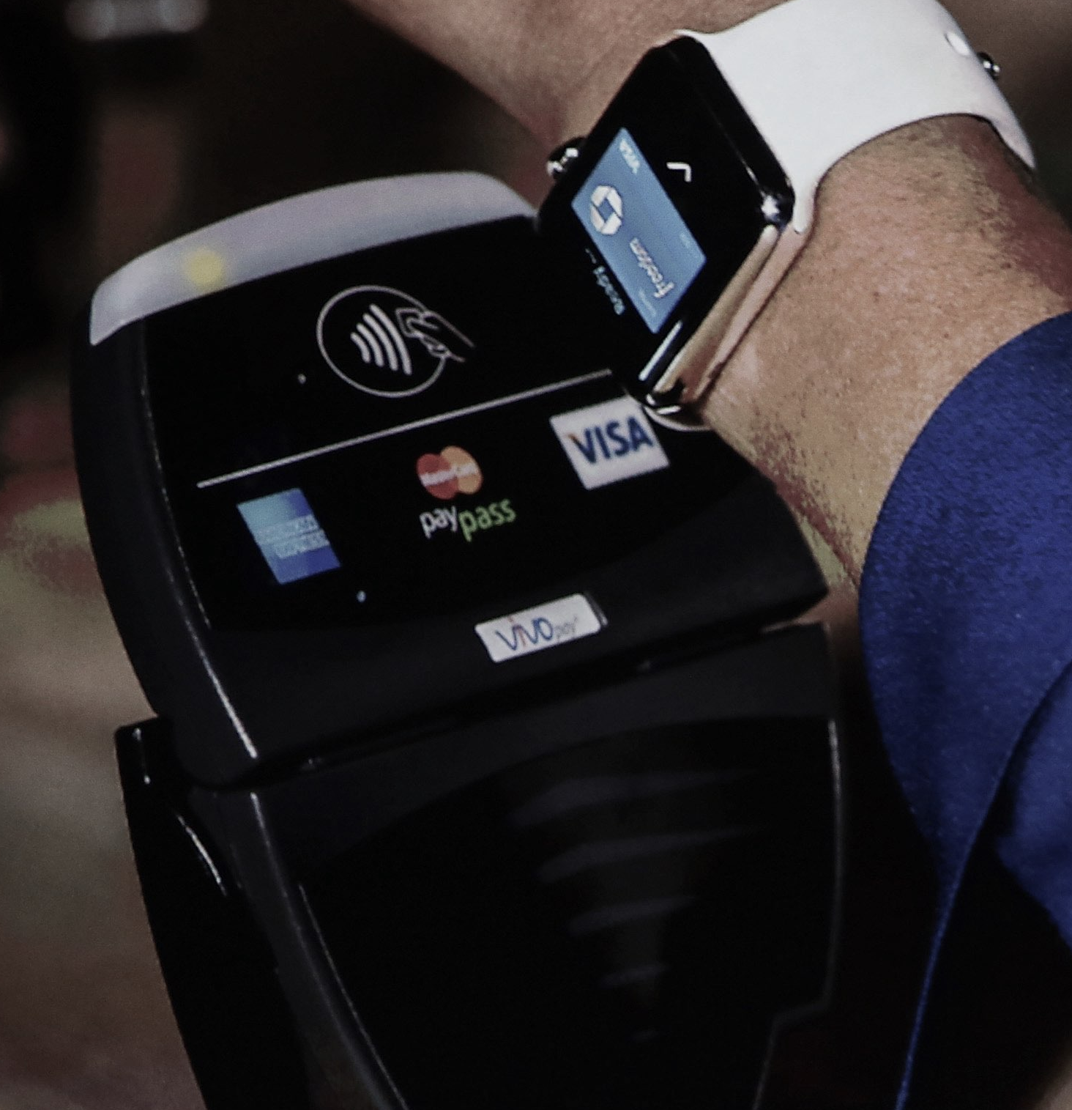
COMPLEX TECHNOLOGY LANDSCAPE
NFC
Wearables
Beacons with BLE
HCE
Notes:
Other key factor the rapidly changing technology landscape.
Some years ago the Near field communication technology - or with other word the NFC - ruled the market.
Today people are using wearable devices for payment e.g. they are paying with their smart watches. Besides NFC here is the Beacon with low energy bluetooth technology and the Host card emulation (HCE).
Host card emulation is the ability for information transfer to happen between a NFC point of sale terminal and a mobile device application configured to act or pretend to emulate the functional responses of an NFC card.

Slide 5
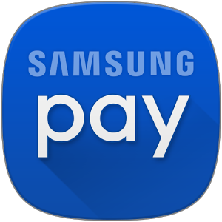
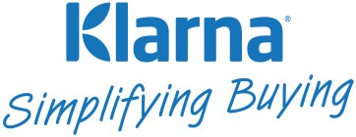
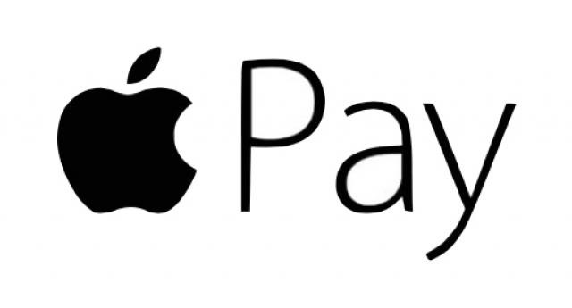
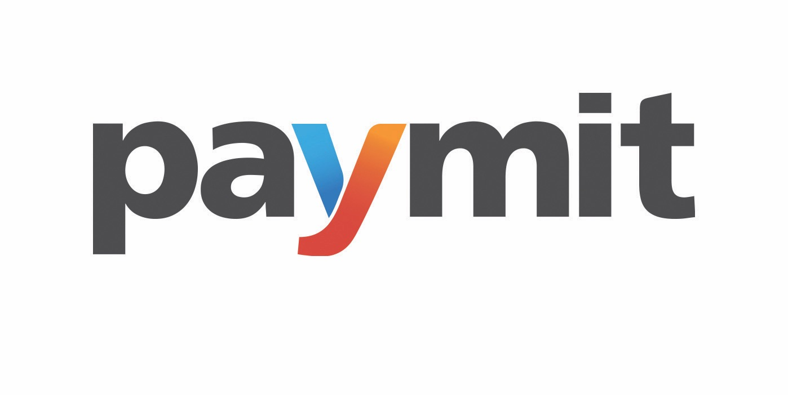
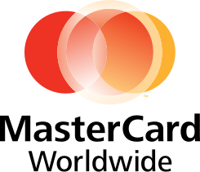

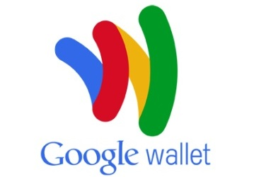
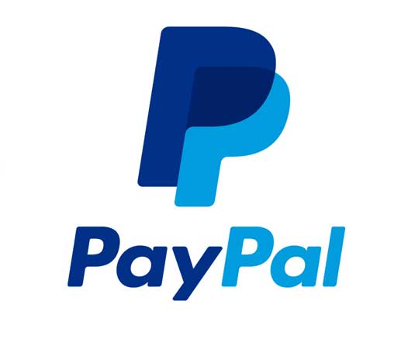
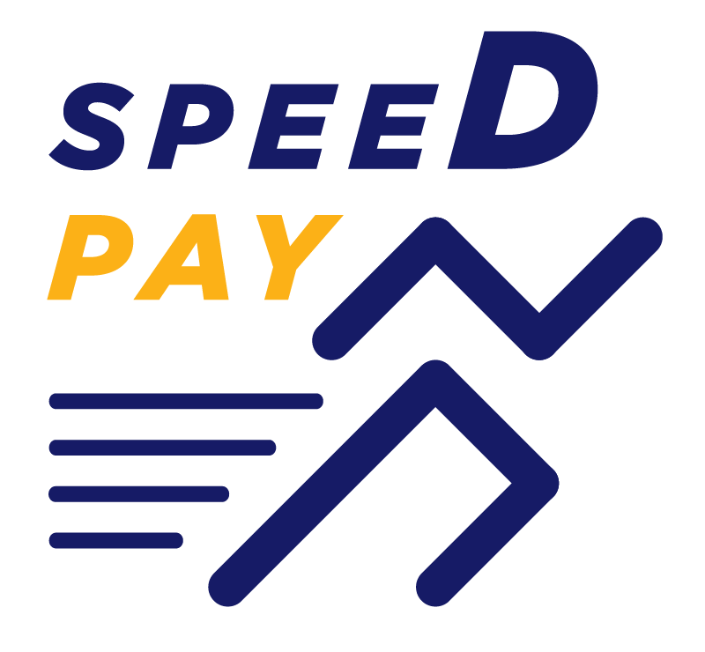


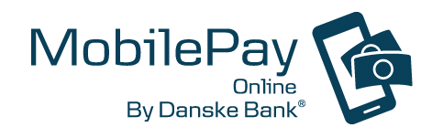



FIERCE COMPETITION
Telcos
Retailers
Tech giants
Startups
Banks
Credit card companies
Notes:
Also another key factor the fierce competition which characterise the market.
New financial and non-financial players changing the competitive landscape and there are many of them. Telcos, retailers, tech giants, startups, banks, credit card companies all working very hard to invent the perfect solution.

Slide 6

REGULATORY CHANGES
Cross-border payment protection (SEPA)
Demand timely responses (PSD, PSD2)
new types of payment services
Interchange rule changes
Compliance requirement
Notes:
There are couple of regulatory changes. One of the most known is the Single Euro Payments Area (SEPA). Its aim is to improve the efficiency of cross-border payments and turn the fragmented national markets for euro payments into a single domestic one.
The dynamics of the regulatory environment also demand timely responses,
In 2007 the Payment Services Directive called PSD was adopted by the European commission to establish safer and more innovative payment services across the European Union. In 2013 The Commission proposed to review the PSD to modernise it to take account of new types of payment services, and introduce more strict interchange rules.
So in 2015 they introduced the PSD2 and all the market players have to accept the regulation.
If someone becomes player in this market, they must fit the compliance requirements of these regulations.

Slide 7
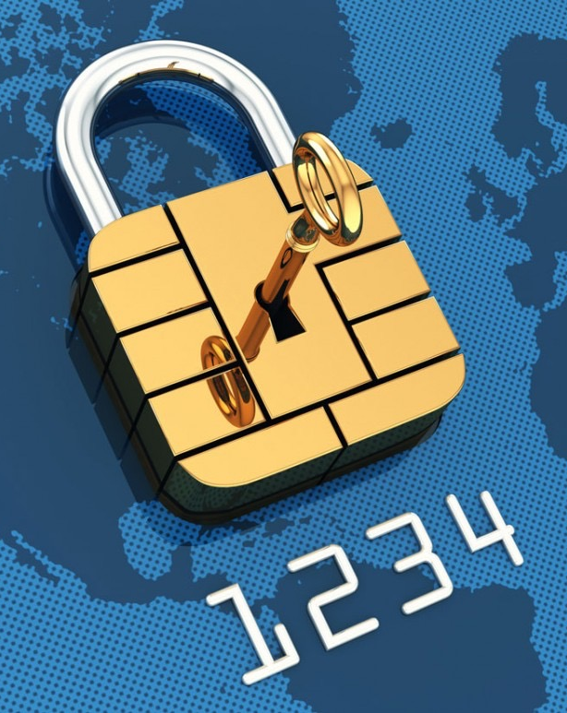
SECURITY CHALLENGES
Vulnerabilities
Stealing and misusing customer data
Lack of data protection solutions
Performance bottlenecks
Expensive security schemes
Notes:
And last but not least there are many security challenges needs to be solved.
New processes create new security vulnerabilities. (válnra bilitiz)
Sending customer identification data through the air potentially creates new attack vectors to steal and misuse customer data which can lead to painful disclosures and fines.
Failure to understand exactly where and how sensitive account data is stored and transmitted can prevent organisations from clearly defining and implementing data protection solutions.
Rising transaction volumes can lead to performance bottlenecks which degrades the customer experience.
Sluggish and expensive security schemes can prevent an organisation’s ability to adapt quickly to new opportunities.

Slide 8
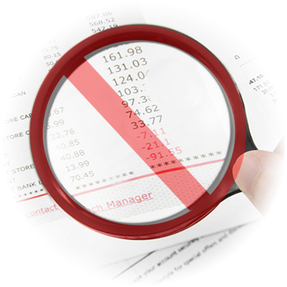
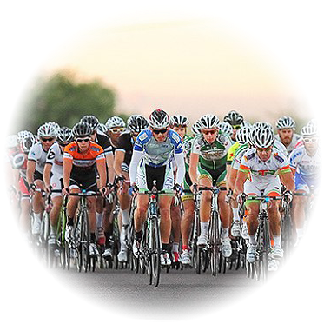
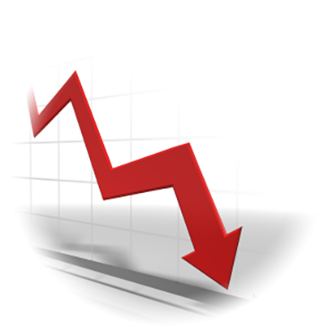
PROFITABILITY PRESSURE
+
=
Regulatory changes
Competing solutions
Low profit
Notes:
Considering all these circumstances,
so the interchange fee reductions, security concerns, the new competitive landscape with the diverse technology options - these all drives the profitability down.
And the world of payment is changing in a really fast pace.

Slide 9
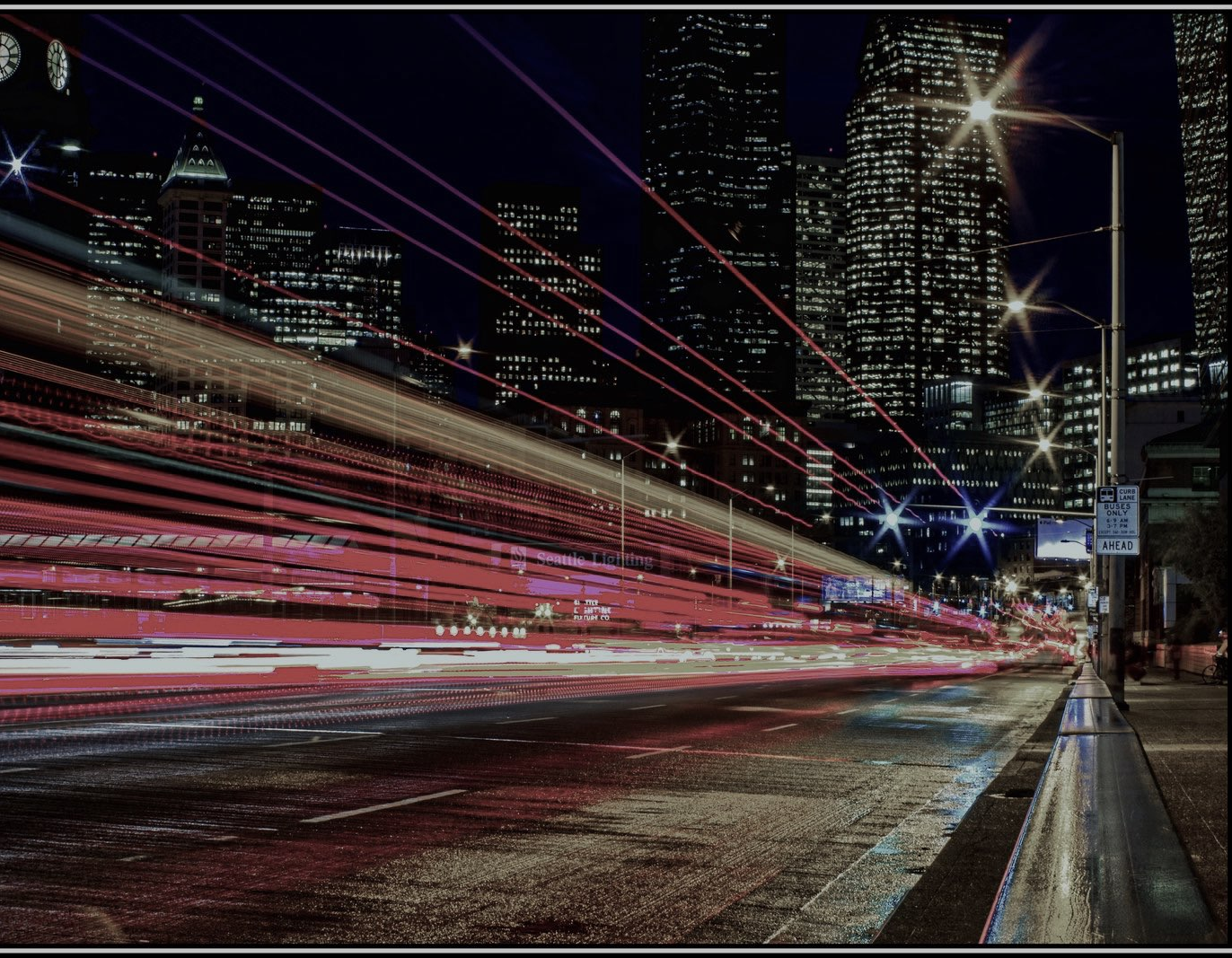
what makes a cashless
payment service successful?
Notes:
But despite of these what makes a digital payment service successful? Cause we know couple of good examples.
But let’s see something what the market struggling with.

Slide 10
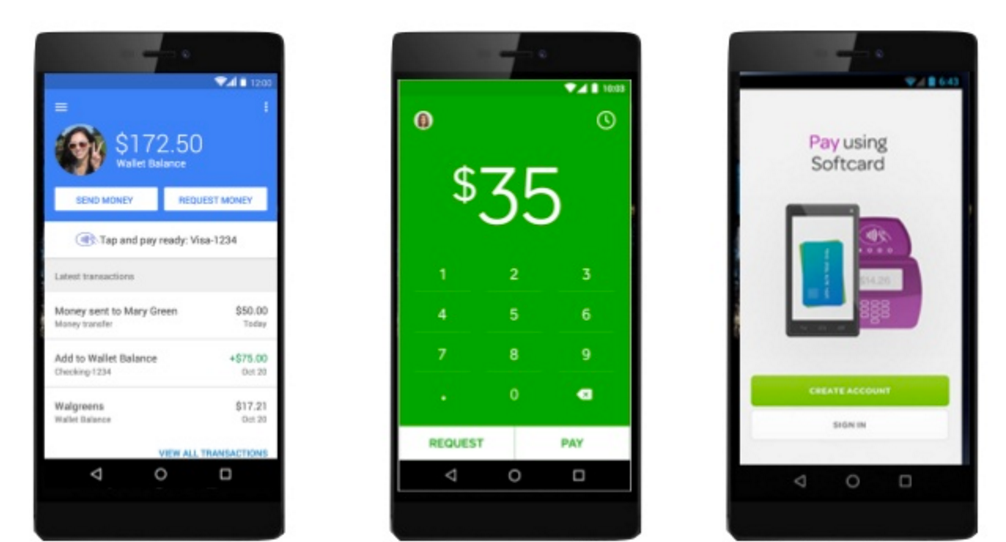
DIGITAL WALLETS
Google Wallet
-$300M
Square Wallet
-$25M
Terminated 5/2014
Isis/Softcard
-$100M
Terminated 3/2015
Notes:
The digital wallets. 2 years ago there was a hype around these applications, let’s see where are they now.
Google wallet, -300 mil, invested
Square wallet, -25 mil they already shoot it down in May 2014.
Isis/Softcard -100 mil also terminated in March 2015
What was the problem?

Slide 11
?
ADDED UNIQUE VALUE AND
DELIVERED AGAINST KEY PAIN POINT
Notes:
It’s not that surprising. if we know what are the most important factors of successful inventions.
successful inventions have added unique value, and always delivered against a key pain point,
successful inventions should have at least one of these two markers:
Let’s see the digital wallet concept from this perspective.

Slide 12
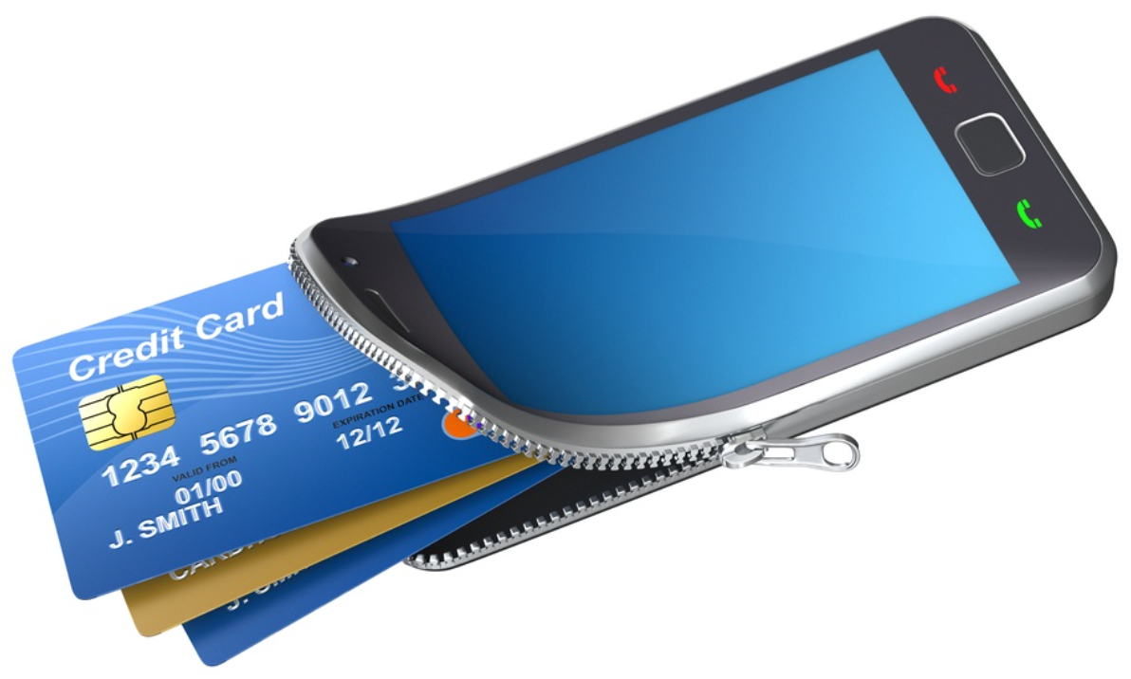
UNIQUE VALUE
Literal translations of an analog wallet
Notes:
Do wallets have unique value?
Not really, as those are just literal translations of a physical wallet.

Slide 13
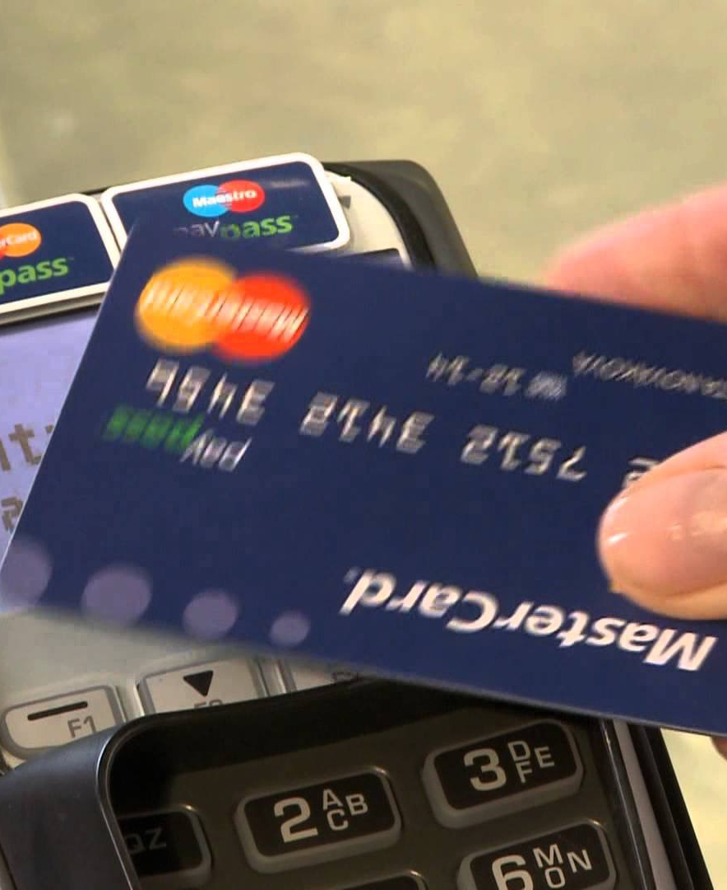
DELIVERED AGAINST KEY PAIN POINT
Using a credit card
is a good practice
“swiping a card at checkout
is one of the easiest things
consumers will ever do”
- Bill Ready, CEO, Braintree
Notes:
Are those against key pain point?
Again not really. Lets see the credit card.
Reaching for the wallet is easy
Credit Card companies are handling the security burden
Plastic cards are widely accepted
Credit is mitigating the ‘abstract pain of payment
so there is no problem with credit card at all. really.
As this quote says:
“swiping a card at checkout is one of the easiest things consumers will ever do”

Slide 14
MOBILE PAYMENT ACCEPTANCE
62%
54%
70%
Easier to pay with Credit/Debit cards
No sensitive information on phone
Don’t transmit sensitive information to the merchant
Notes:
Also digital payment creates new pain points.
According to the statistics in 2015 54% of the involved consumers thought its easier to use CC than mobile for payment.
62% of the same consumers said they don’t want to store sensitive data on their smartphone and even more 70% said they don’t want to send personal data to merchants.

Slide 15
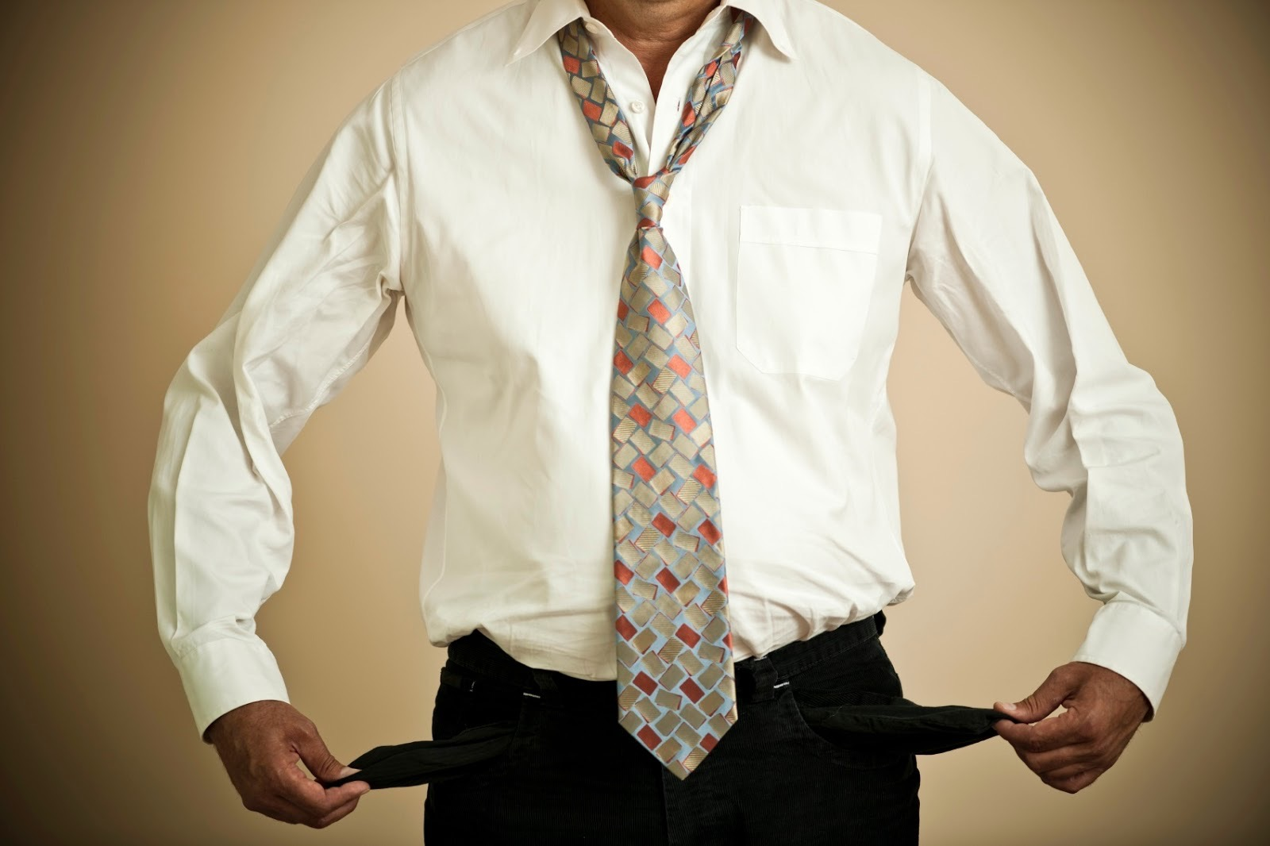

NO CASH OR CARD, JUST MOBILE
Notes:
Based on this lets play with the idea, and leave all cash and credit card at home. So just mobile for a week.
In some countries it would be ok, we would not starve to death, but it’s almost 100% sure we had to borrow some cash after a while.

Slide 16



TOOLS THAT ENABLED
ACTIONS IN A NEW WAY
Notes:
Successful digital versions of analog products have never been literal translations,
but tools that enabled action in a new way.
Almost all of you probably know Amazon and it’s Kindle. Its not just about replacing the book stores, its about making millions of books accessible from your chair at home.
Or Skype, wasn’t about replacing the phone but a better cheaper form of communication, even from the other side of the world.
And iTunes is not about a replacing a CD, its about a better ways to consume music, and it actually blowed up the whole music industry.

Slide 17
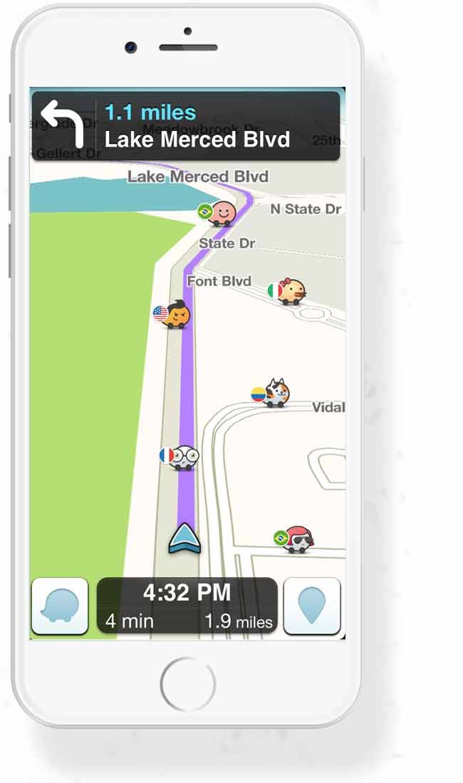
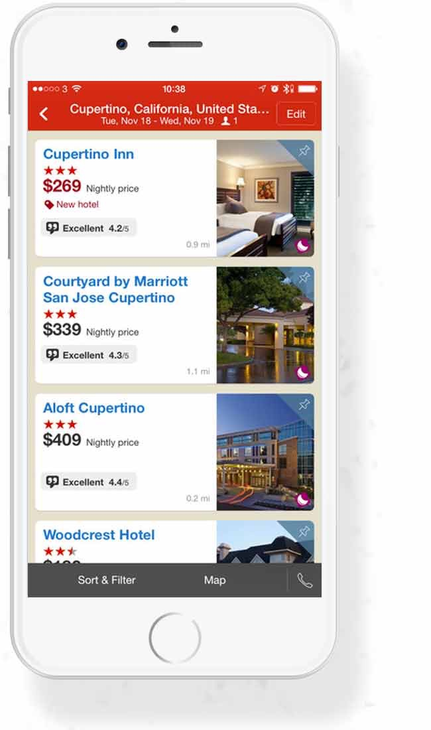
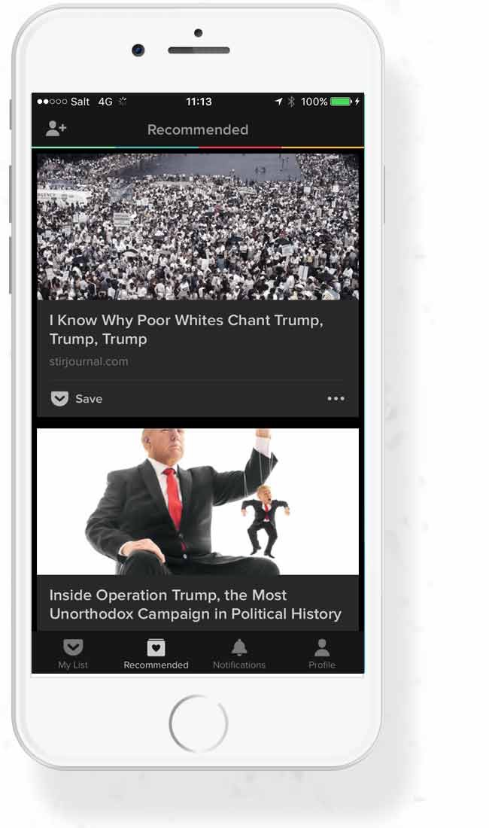
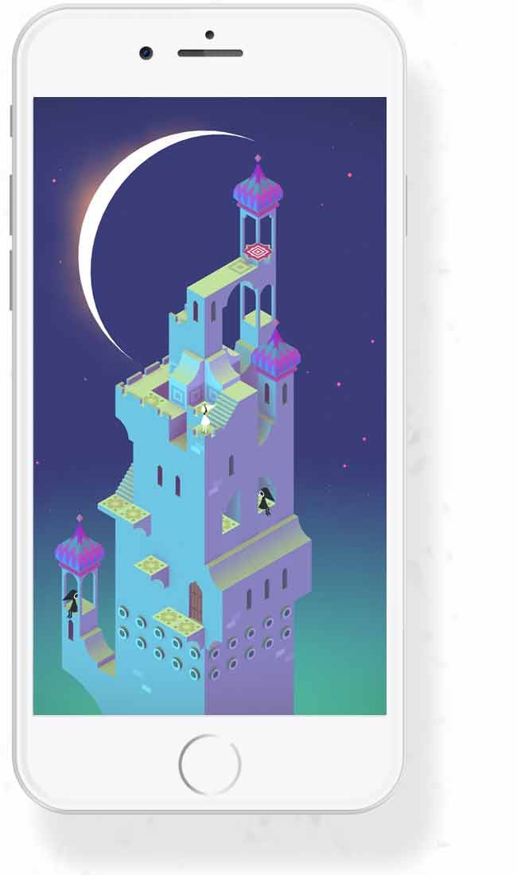
THE 4 TRAITS
WAZE
HOTELS.COM
POCKET
Monument Valley
EFFICIENCY
EFFECTIVENESS
CONTEXTUALITY
ENTERTAINMENT
“Make something easier”
“Save time or money”
“Personalised insights”
“Fun and Cool”
Notes:
So stepping outside for a tiny bit our category we may see that apps that do solve a key pain point and deliver customer value have 4 traits.
What are these?
An app can be efficient, like the WAZE app, as it’s not just a GPS, but because its community driven you know in advance where are the traffic jams and roadworks.
It can be effective, like the hotels.com application. With its help you can save time and money, and you can easily organise a roundtrip. Furthermore you can get reward for your loyalty, what can make your holidays even cheaper.
It can be contextual, like the pocket app from google, where you can save articles for later read, and also see recommendations based on your interest.
And of course it may be entertaining. No one likes boring stuff, especially if its a game. Interesting concept and amazing visualisation, thats why this game the Monument valley is so popular. If you don’t know it you should try it.

Slide 18

SUCCESSFUL MOBILE PAYMENT SOLUTIONS
Deliver against key pain point
Add a unique value
Enable an action in a new way
Share some of the 4 traits
Notes:
When we see successful digital payment solutions
we see that
- they are delivered against key pain point
- they have unique added value
- they enable an action in a new way
- they share some of the 4 traits
In most of the cases the core competency and the added value is not the payment itself.
Payment is an integral part of the value chain which is usually seamless and transparent.
But with a smart idea the payment itself can also be unique and enable action in a new way.
Lets see some examples

Slide 19

STARBUCKS
15% of all transactions
Pain points:
Managing loyalty program
Miscommunication order
Waiting time
Added value:
Personalisation
Seamless payment
Pre-order
Notes:
Starbucks
In the US it is very popular: In 2015 15% of all transactions went through this application.
The main Pain points was that their loyalty program was not well organised. With the application now is much easier to manage. There was a lot of conflicts when people didn’t get what they wanted cause of misunderstanding and also especially in rush hours (mornings and evenings) the waiting time was just too much.
And the application was able to solve these problems. As you may see in this small video with personalisation, and the embedded loyalty program, they developed a useful app, where the payment is seamlessly integrated, and customers are easily pre-order product which are ready for pick-up at the time of arrival.

Slide 20
UBER
valued at $50 billion
Pain points:
Finding a TAXI
Uncertain arrival
Payment and tipping
Fear from strange drivers
No relationship with the driver
Added value:
Information about driver
Precise arrival
Rating and review
Payment integrated
Notes:
Uber
The Uber was founded in 2009 as a Luxury car service, now it worth $50 billion.
It was a transformation in the meantime it became an alternative of the taxi service. Why? Finding a taxi is a pain point, also hard to estimate the arrival of a taxi. Most of the cases they were accepting only cash, was difficult to manage the payment. Especially where it is not regulated, you don’t know where do you sit in. So there was a fear from strange drivers, and even if something bad happened there was no platform to share this experience.
Uber gave the answer for these pain points, as in the application you can instantly see reviews from the driver, also you can easily predict the arrival time, you can rate and review the experience and the driver through the app, and also payment is seamlessly integrated.

Slide 21
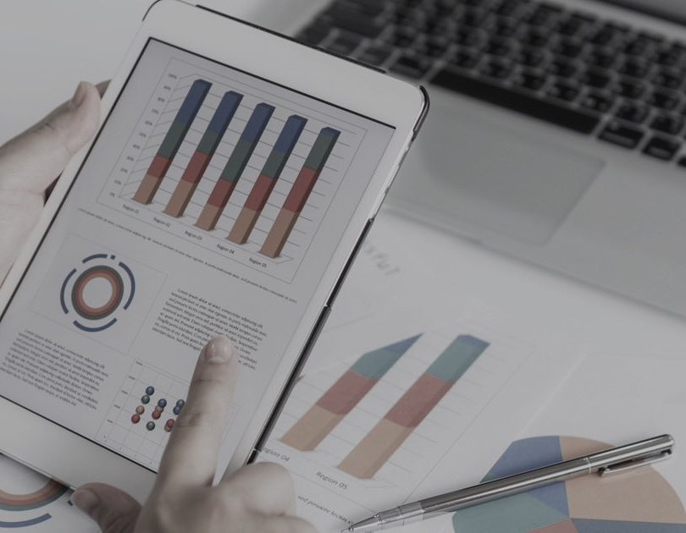
Financial applications
Notes:
Financial companies are also continuing to create transaction based apps, and if we look at banking apps globally, we see that few actually make this cut.

Slide 22
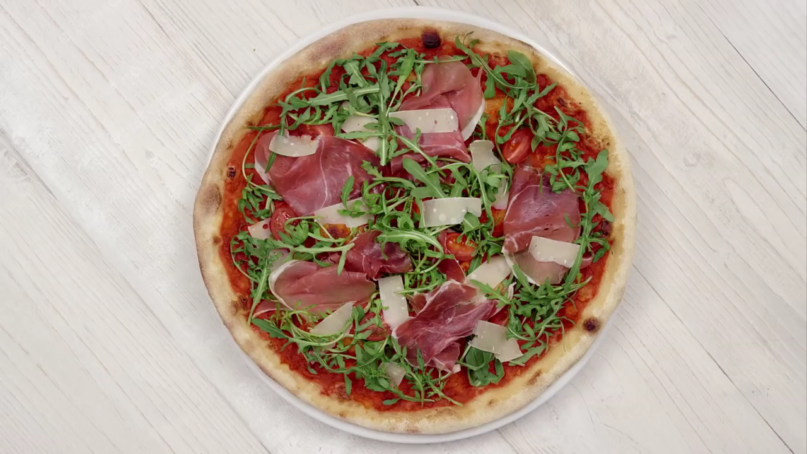
PAYMIT
Notes:
Here in Switzerland we have Paymit. Let me show this small video about it.
video play
So sending and receiving money is easy as pie with this app also sharing a bill, or having transaction record.

Slide 23
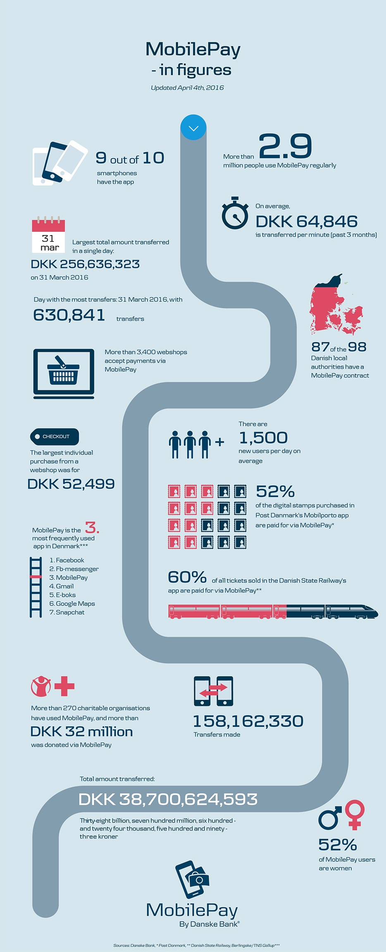
MOBILEPAY
Notes:
Not too far from us in Denmark in May 2013 they’ve introduced their MobilePay app, and as you can see in this info-graph they made a huge progress in 3 years. Now the app is installed on 9 out of 10 Phones. More than 2.9 million people using it on a daily basis. Approximately 8700 EUR goes through on it every minute, the largest amount on a single day was 34.5Mil EUR. It meant 630 thousand occurrence.
Facts are:
1500+ more users / day
50% of postal stamps and 60% of train tickets bought by mobile pay
The 3rd most frequently used app in Denmark after Facebook
160 million transaction more than 4.5 billion EUR transferred so far
Charities also using the app successfully more than 4.3 million EUR was donated via MobilePay.
The app is becoming increasingly widespread as a payment solution and can be used in thousands of shops, supermarkets and restaurants as well as in other apps and for online purchases.
I think that’s the goal for the SIX paymit app for the next 2-3 years.
But I think focusing on financial transactions alone set limitations, because consumers don’t live their lives that way, they live in the moment

Slide 24

Notes:
Let me show you a video made by Google about this. This video illustrates the idea consumers living in the moment.

Slide 25
WHAT DOES THIS MEAN?
62%
82%
90%
turn to their smartphone to influence the decision in a store
take action to solve an unexpected problem because they have smartphone
use their phone to make progress toward a long term goal
Notes:
What does this means? Just a few statistics about consumer habits:
82% of smartphone users turn to their smartphone to influence a purchase decision during shopping. As an example, when I buy TV, or PC part, or some sport shoes I try to check on my phone where can I buy it even cheaper and also, try to find some user reviews to valuate the product.
62% of smartphone users are more likely to take action right away toward solving an unexpected problem or new task because they have smartphone e.g. If I feel bad, or I don’t know where to go, I always try to check my phone first.
90% of smartphone users have used their phone to make progress toward a long term goal or multi-step process while “out and about” the best example is the fitness tracking. Most of us uses some kind of app or device, where we continuously measure our progress of running, biking etc. This helps us to maintain the long term goals, and keep being motivated.

Slide 26
IWWIWWIWI
I want what I want when I want it
WHAT
WHEN
where
HOW
Notes:
consumer wants to live in the moment and expect instant gratification to their actions.
If the utility offered not relevant for the particular moment they have no interest in it.
In other words the consumer want what they want when they want it.
Our duty is to understand what they want when they want it, where they want it and how they want it.
Once we know this we can start thinking about how payment can be a part of it.

Slide 27

RECENT INNOVATIONS
Notes:
By listening to the customer needs and applying a user-centric approach, we can generate payment solutions, which are relevant to customer lifestyles.
Lets look at some recent innovation in payment - and let me include our Swiss hackathon winner idea - and explore how they fulfil human needs and tap into moments of desire, ultimately leading them to own the payment itself.

Slide 28
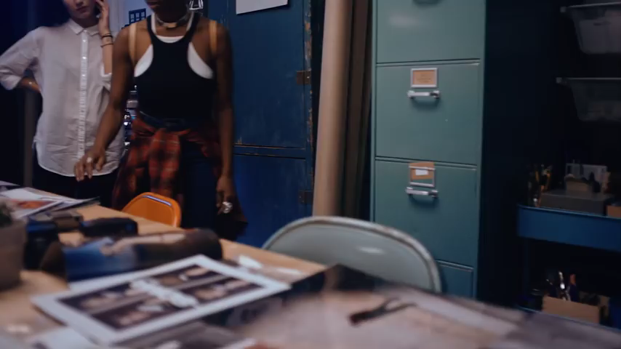
Pinterest
Buyable pins
Buy items directly
At the moment people started their interest
Notes:
Pinterest - buyable pins
People create Pinterest boards where they collect photos, items and design which can serve them as inspiration for things they find interesting or they would like.
Last year they added buyable pins which enable consumers to buy items directly from pinterest.
Reaching people at the moment when they have already started their interest and giving them what they want.

Slide 29

Amazon
DASH
Order and pay by a push of a button
Notes:
Amazon Dash
It’s a new product, you can order and pay for items by pushing a button
At the moment the consumer notice they need a product, the solution is already there. In this case payment is the least interesting part of the process, so its fully transparent.

Slide 30
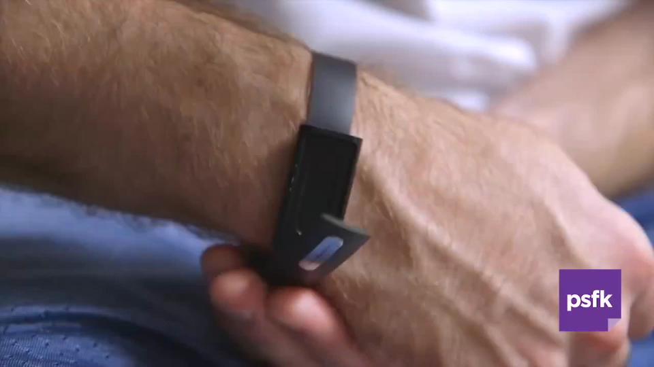
Nymi
Nymi band
Continous biometric authentication for payment
Uses the HearthID
Notes:
Nymi band
The Canadian Nymi Band is world's first biometric authentication wearable, ensuring payment by identifying the unique rhythm of the wearer's heart

Slide 31
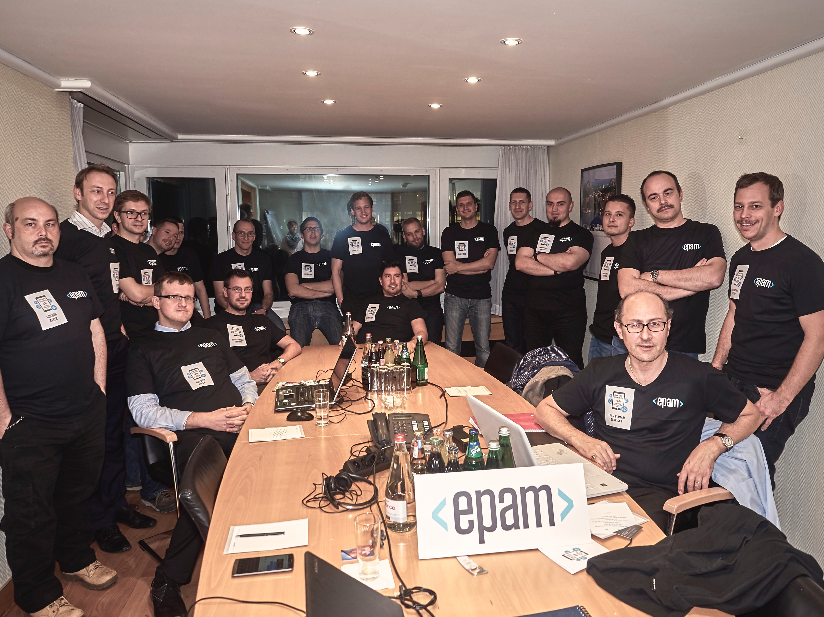
THE EPAM hachathon
Notes:
A Payment related pain point led us to the EPAM Hackathon, to challenge ourselves, and try our idea.

Slide 32

THE PAIN POINT
Waiting for the waitress
Waiting for your order
Waiting for the bill
Notes:
The main problem what we tried to eliminate was the waiting time:
You go to the restaurant find a table and start waiting for the waitress
You make the order and wait for the drinks and food
You ask for the bill when you’re done and wait for the waitress again

Slide 33

OUR SOLUTION - THE ADDED VALUE
Instant, transparent ordering
Waiting for your order
Instant payment
Waiting for the waitress
Waiting for your order
Waiting for the bill
Notes:
So we invented the BuyBye application.
Let’s see an example: A man walks into a restaurant and sit on an empty table. He scans the QR code or hold his mobile to the contactless beacon and makes his order. Then when he finish the lunch just tap on the pay button in the app and leaves the restaurant.
The only waiting time was remained was the waiting for the food… maybe next time we solve that problem too… :)

Slide 34
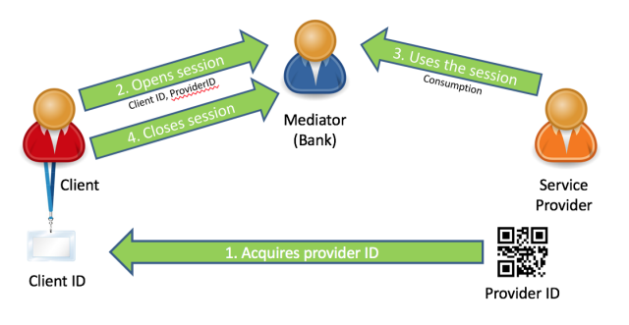
IN THE BACKGROUND
Notes:
Let me explain a little how it should work in the background and highlight some other benefits.
The application places banks in the role of intermediary between their clients and various services - so the payment will be guaranteed trust established.
Session is on when the customer start his order - restaurant, bank and customer are all aware of the ongoing transaction
After payment bills are stored in the cloud, so can be accessible anytime - business can also analyse them and do statistics.

Slide 35
WE WON BECAUSE…
1
Pain point was real
2
Agile approach
3
Effective, efficient, contextual and entertaining
4
Multidisciplinary team
5
Right technology stack
Notes:
Why were we successful? Why did we win the competition with our idea and solution?
We answered to a real pain point, the waiting
We were developing features not completeness - so we were agile
base features (must have) which was already contained added value
nice to have features
We identified the right messages (also in the presentation) - we succeeded at least 3 of the 4 traits: it was effective - by saving time, contextual - as it was always shown the actual consumption, it was efficient - as we integrated the payment functionality, and maybe it was not entertaining for an average consumer, but it was for us, to make it happen…
Our team had multidisciplinary skillset - backend to front-end, JAVA to JavaScript, designer skills and also presentation skill was present
And finally we choose the right technology stack - even if it was right only for the prototype, the “customer bought it”

Slide 36
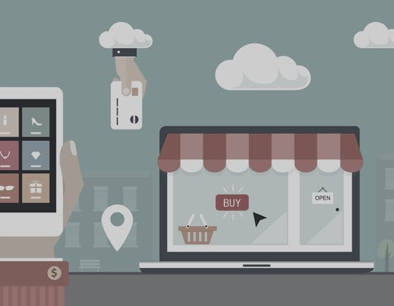
FUTURE OF DIGITAL
PAYMENTS
Notes:
What could be the future really? Hard to predict.

Slide 37
GLOBAL MOBILE PAYMENT TRANSACTIONS
Forecast from 2015 to 2019
(in billion U.S. dollars)
100%
GROWTH IN
3 YEARS
Publication published by NFC World+ February 2016 nfcworld.com
Notes:
According to the forecast the mobile payment transaction quantity will be doubled in the next 3 years, so in 2018 it will almost reach 1 trillion (1000 billion) USD.

Slide 38
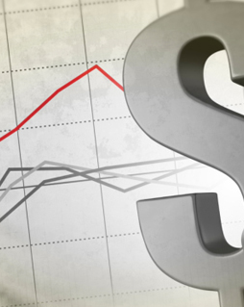
THE FUTURE OF CASHLESS PAYMENTS
“Forecast is that more than 50 percent of incremental revenue in almost all banking products in Western Europe will be digital by 2018.”
-McKiney & CO
“ The worldwide mobile payment volume in 2015 was 450 billion U.S. dollars and is expected to surpass 1 trillion U.S. dollars in 2019.”
-Statista
“The total value of mobile payment transactions in the US will grow 210% in 2016”
-eMarketer
“The number of people who make a mobile payment at least once a year will grow from nearly 8% of the US consumer population in 2014 to 65% by 2019. ”
-Business Insider
“By 2018, 50 Percent of Consumers in Mature Markets Will Use Smartphones or Wearables for Mobile Payments”
-Gartner
Notes:
All big financial and management consultancies predict big progress in the digital payment area:
“Forecast is that more than 50 percent of incremental revenue in almost all banking products in Western Europe will be digital by 2018.”
“ The worldwide mobile payment volume in 2015 was 450 billion U.S. dollars and is expected to surpass 1 trillion U.S. dollars in 2019.”
“The total value of mobile payment transactions in the US will grow 210% in 2016”
“The number of people who make a mobile payment at least once a year will grow from nearly 8% of the US consumer population in 2014 to 65% by 2019. ”
“By 2018, 50 Percent of Consumers in Mature Markets Will Use Smartphones or Wearables for Mobile Payments”

Slide 39
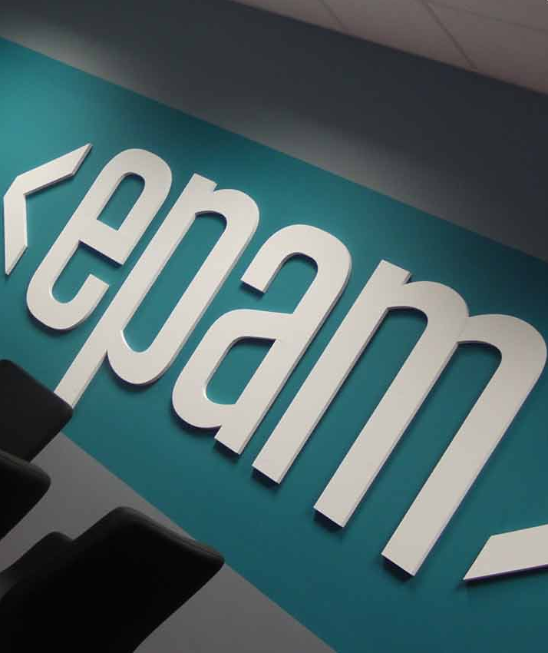
EPAMS ENGAGEMENT FOR THE NEXT 3 YEARS
Focus to fintech innovations
Sponsor technology events
Domain specific competency
POCs / Prototypes / Accelerators
Notes:
Epam’s engagement is key, as our most important area of revenue source is the financial sector at the moment, and regardless how the other sectors are growing, we should really focus to this area.
I imagine a company with a lot of events like our Hackathon, focusing on Fintech, or other technology events we sponsor, or held to strengthen the domain-specific knowledge of our colleagues.
Also we need to build a solid domain-specific competency both in web and mobile technologies, and create POCs prototypes and accelerators that would enable us to showcase such innovating ideas to our clients and implement them if there is interest.

Slide 40
THANK YOU
KONRAD HEFELLE
Konrad_Hefelle@epam.com
Notes:
Thank you for your attention, I hope you enjoy the IT week so far, don’t hesitate to contact me on Yammer or via email if you have any question.

